Slide 1
Digital Circuit and System Lab09 AHB handshake
20250515
TA: 陳祖喬 Tsu-Chiao, Chen
Institute of Electronics,
National Yang Ming Chiao Tung University

Slide 2
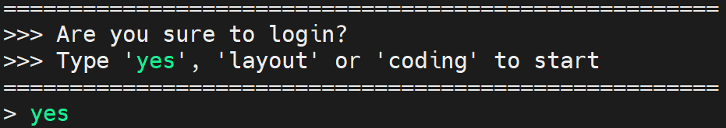
Environmental preparation
type ‘yes’ while you login the server
Extract files from TA’s directory (home directory)
tar -xvf ~DCSTA01/Lab09.tar

Slide 3
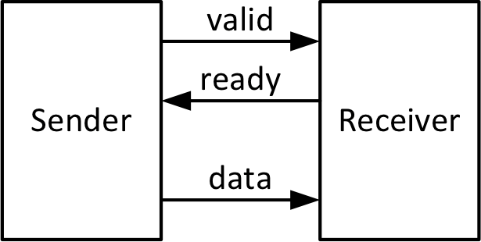
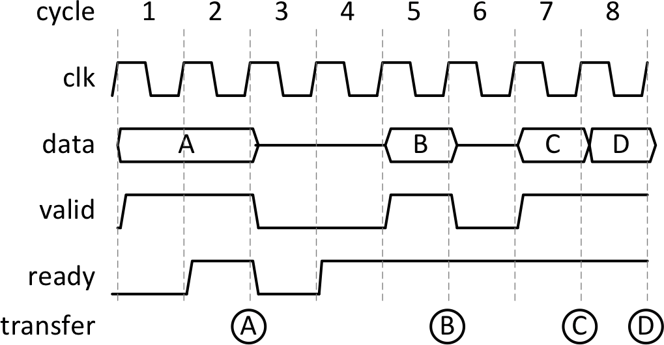
Flow Control: ready-valid flow
Ready 或valid 兩者都為1才能傳

Slide 4
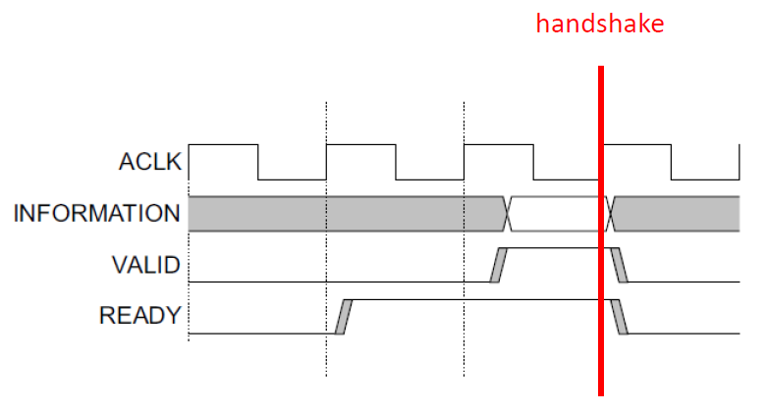
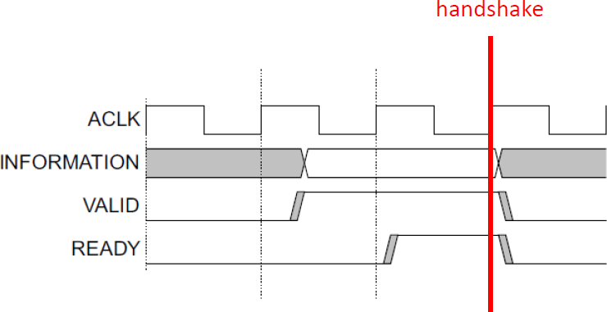
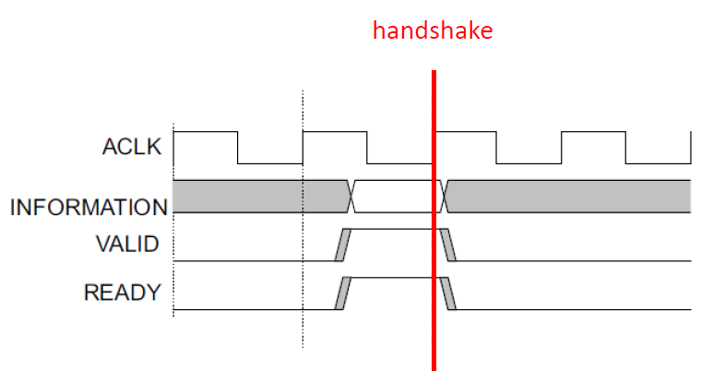
Handshake process
Ready before valid / Valid before ready
Valid with ready
If(valid && ready)

Slide 5
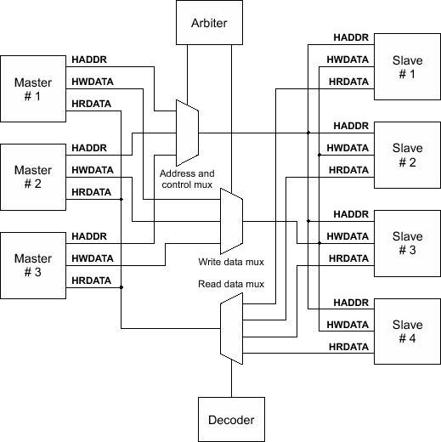
AHB Interconnect
Basic components:
Master
Slave
Arbiter
Decoder
Mux

Slide 6
Lab - block diagram
Pattern
Slave memory 1
(done by TA)
Master1 Master2 Master3 (done by TA)
Interconnect (inter.sv)
Slave memory 2
(done by TA)

Slide 7
Lab
Masters will send input data to interconnect
You should decode input data for valid, address and value
Based on master priority(1->2->3), send data to slave memory
Output handshake signal
[6:0] data_in_1 (from Master1)
data_in_1[6]: 0->slave1; 1->slave2
data_in_1[5:3]: address
data_in_1[2:0]: value
Ex: 7’b0101001 for slave1, addr=5, value=1
Ex: 7’b1011110 for slave2, addr=3, value=6

Slide 8
inter.sv
Input Signal | Bit Width | Definition
clk | 1 | Clock
rst_n | 1 | Asynchronous active-low reset
in_valid_1 | 1 | in_valid from master1
in_valid_2 | 1 | in_valid from master2
in_valid_3 | 1 | in_valid from master3
data_in_1 | 7 | Data from master1
data_in_2 | 7 | Data from master2
data_in_3 | 7 | Data from master3
ready_slave1 | 1 | Ready signal from slave1
ready_slave2 | 1 | Ready signal from slave2

Slide 9
inter.sv
Output Signal | Bit Width | Definition
valid_slave1 | 1 | valid signal to slave1
valid_slave2 | 1 | valid signal to slave2
addr_out | 3 | Address you want to write
value_out | 3 | Value you want to save
handshake_slave1 | 1 | High for 1 cycle after handshake with slave1
handshake_slave2 | 1 | High for 1 cycle after handshake with slave2

Slide 10
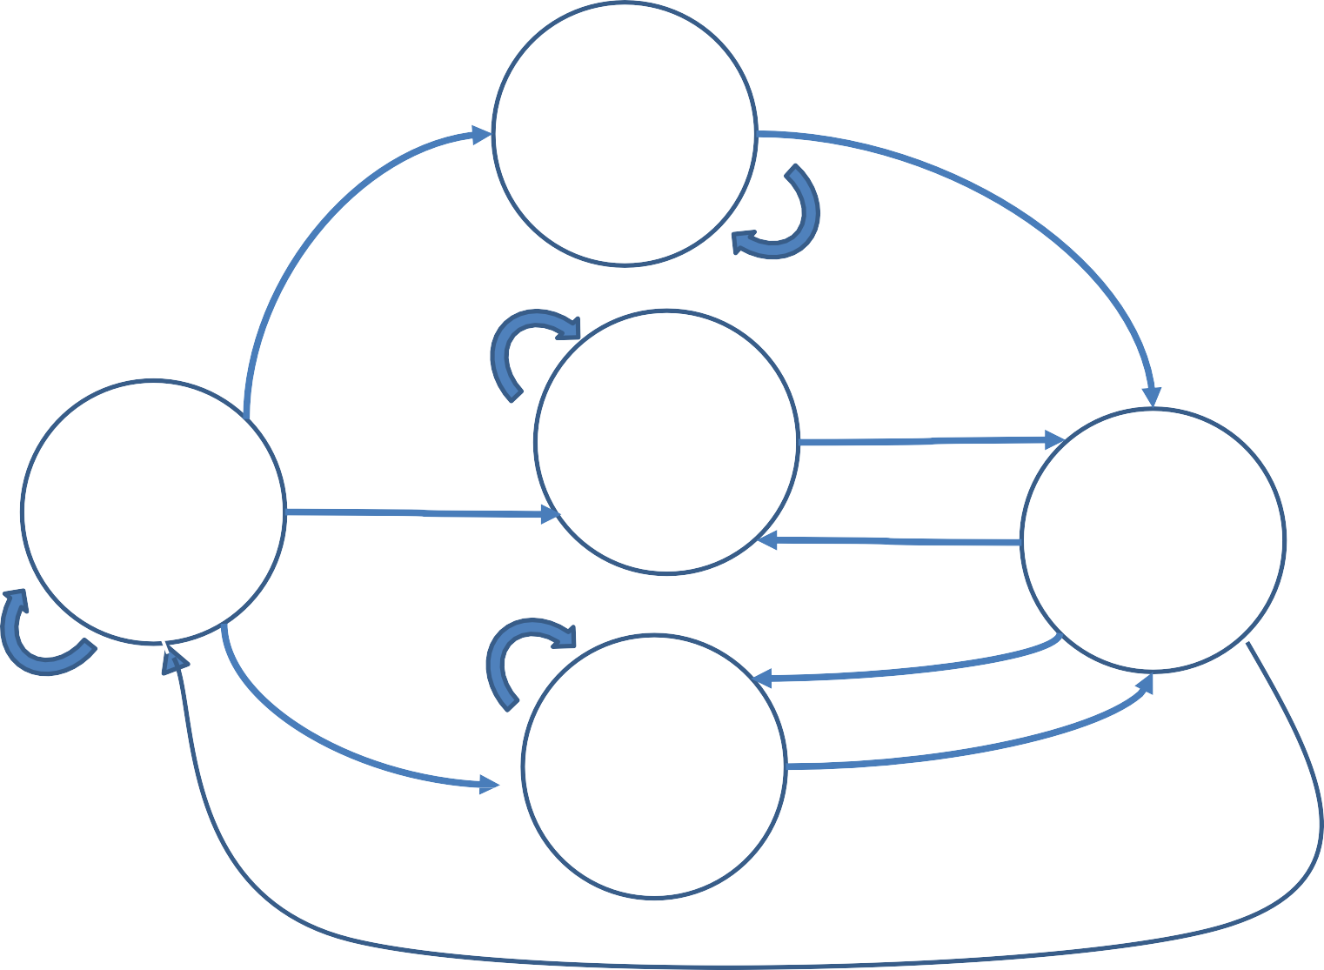
Lab – FSM (ref.)
S_master1
Valid&ready=1
In_valid_1=1
Set valid high, wait ready
Valid&ready=1
In_valid_1=0 In_valid_2=1
S_master2
S_idle
S_handshake
In_valid_1=0 In_valid_2=0 In_valid_3=1
Set valid high, wait ready
S_master3
Valid&ready=1
Wait next input

Slide 11
SPEC
Cycle time is fixed to 5.0.
It is an asynchronous reset and active-low architecture.
The reset signal (rst_n) would be given only once at the beginning of simulation. All output signals should be reset to 0 after the reset signal is asserted.
All output signals should be synchronized at positive edge of clock.
Handshake_slave signals should be pulled high in 30 cycle.
After handshake_slave signals is pulled high(only 1 cycle), pattern would check all value in slave memory, so master priority must be followed.
You are not allowed to modify syn.tcl.
After synthesis, the timing report should be non-negative (MET).
The synthesis result cannot include any latch and error.
Remember to check if a latch and error are synthesized (./08_check)
The gate-level simulation cannot include any timing violations.

Slide 12
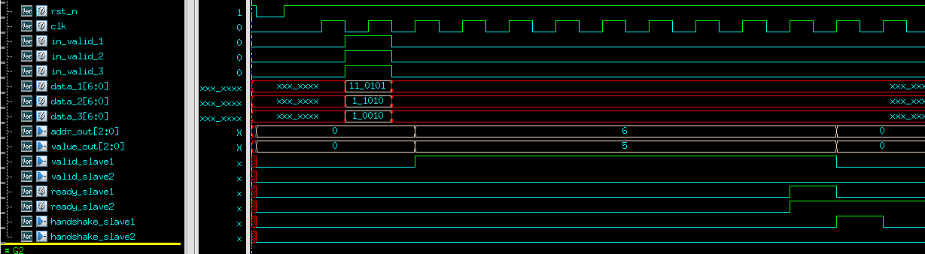
Waveform
negative trigger asynchronous reset

Slide 13
Waveform
Input data

Slide 14
Waveform
Master1 first
Decode: 0 110 101 => slave1 address:6 value:5

Slide 15
Waveform
Set valid high, wait slave1 ready

Slide 16
Waveform
Handshake!

Slide 17
Waveform
output handshake signal

Slide 18
Waveform
Continue for Master2

Slide 19
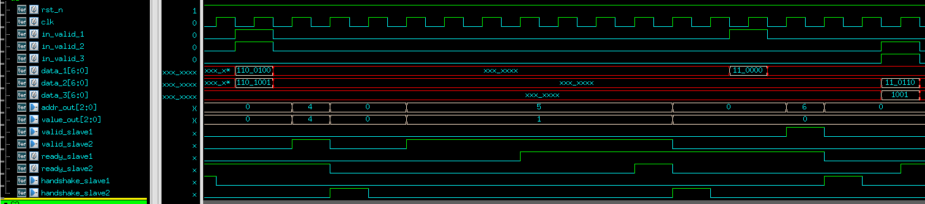
Waveform
Pattern 1
Pattern 2

Slide 20
Command List
Extract files from TA’s directory (home directory):
tar -xvf ~DCSTA01/Lab09.tar
Verilog RTL simulation (01_RTL/):
./01_run_vcs_rtl
Synthesis (02_SYN/):
./01_run_dc_shell
./08_check
Gate level simulation (03_GATE/):
./01_run_vcs_gate
Observe waveform to debug
nWave &
find *.fsdb
shift + L for reload fsdb file

Slide 21
Score
Function Validity: 100%
01_RTL PASS
02_SYN timing slack must be MET, no error and latch
03_GATE PASS, no error and timing violation
You can not adjust your clock period by yourself, the clock period is 5 ns.
09_SUBMIT
./00_tar
./01_submit
./02_check 1st_demo/ 2nd_demo
Deadline :
1st Demo: 5/15 18:20:00
2nd Demo: 5/15 23:59:59

